Slide 1



Chest X-ray Abnormalities Detection

Slide 2
Kulkarni Ganesh Shivajirao
ED16B016
Guide : Ganapathy Krishnamurthi

Slide 3
VinBig Challenge
Object Detection Task
Classifying thoracic lung diseases
Localizing critical findings
15000 total DICOM Images
14 classes with BBox

Slide 4
Image Conversion
Converted DICOM Images to PNG Images
(1024, 1024) size of PNG image

Slide 5
Annotations
Given format of annotations : [xmin ymin xmax ymax] (pixels)
Yolo annotations format : [xmid ymid height weight] (values lies within 0 and 1)
Converted CSV files to yolo annotations format
Train val Split ratio 0.8
No ground label in yolo format

Slide 6

Annotations
4500 images have labels
Empty text file used for rest images

Slide 7
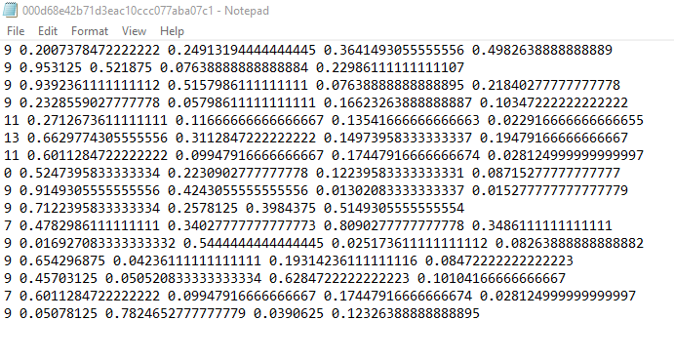
Annotations
Given format of annotations : [xmin ymin xmax ymax] (pixels)
Yolo annotations format : [xmid ymid height weight] (values lies within 0 and 1)
Converted CSV files to yolo annotations format
Train val Split ratio 0.8

Slide 8
YOLO
YOLO: You Only Look Once :Real-Time Object Detection
YOLOV5 :

Slide 9
YOLO V5
Auto Learning Bounding Box Anchors
16 Bit Floating Point Precision
New Model Configuration Files : yolov5 series
CSP Backbone
Very fast, performant

Slide 10
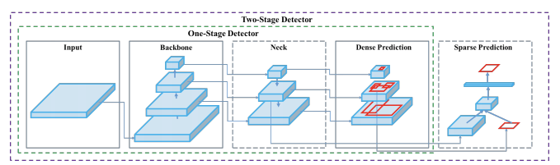
YOLO V5
YOLO Detection Stages

Slide 11
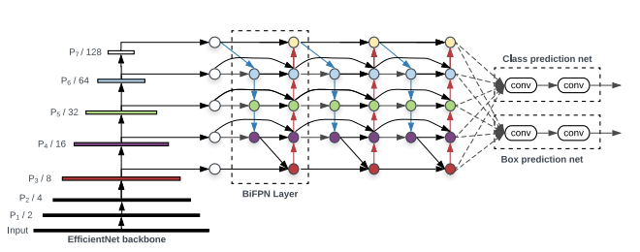
YOLO V5
Model Architecture

Slide 12
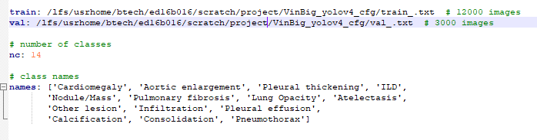
Training
Input Dataset yaml file

Slide 13
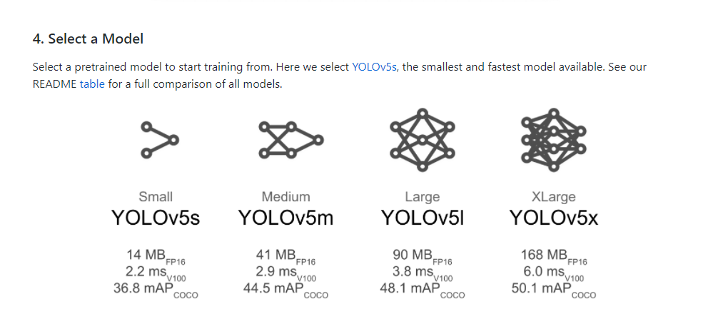
Training
Kept Default hyperparameters
Used pretrained yolov5x model

Slide 14
Thank You

